Slide 1
MongoDB Indexes
Deepak Srinivasan

Slide 2
Index
1. Indexes in MongoDB
2. Before creating Index Stage : “COLLSCAN”
3. Before creating Index executionTimeMills: 8
4. Create Index
5. After creating Index Stage : “INXSCAN”
6 After creating Index executionTimeMills: 10

Slide 3
Indexes in MongoDB
Indexes support the efficient execution of queries in MongoDB. Without indexes, MongoDB must perform a collection scan.
Syntax:
To create index:
db.collection.createIndex( <key index type specification>, <option>)
To Drop index
db.collection.dropIndex( <key index type specification>, <option>)

Slide 4
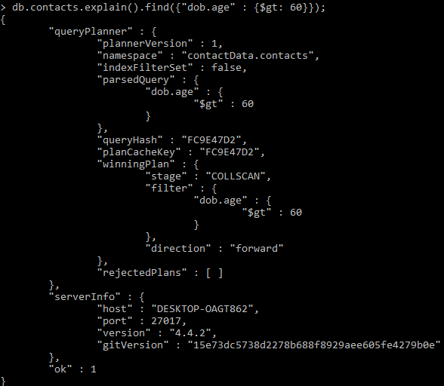
Before creating Index Stage : “COLLSCAN”

Slide 5
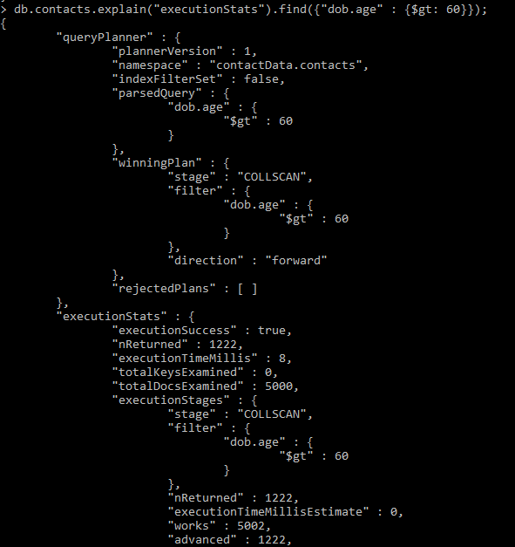
Before creating Index executionTimeMills: 8

Slide 6
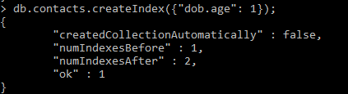
Create Index

Slide 7
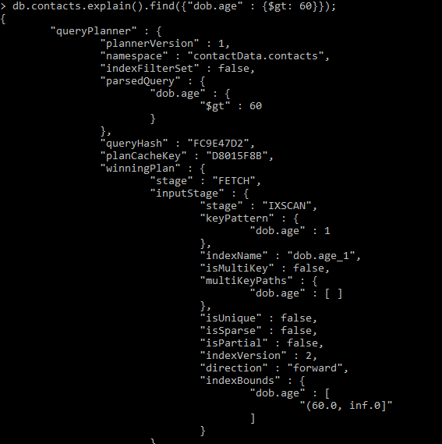
After creating Index Stage : “INXSCAN”

Slide 8
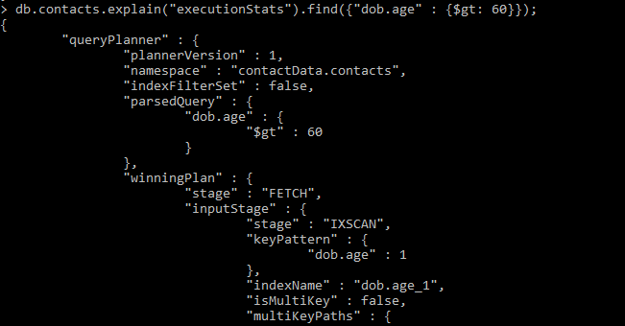
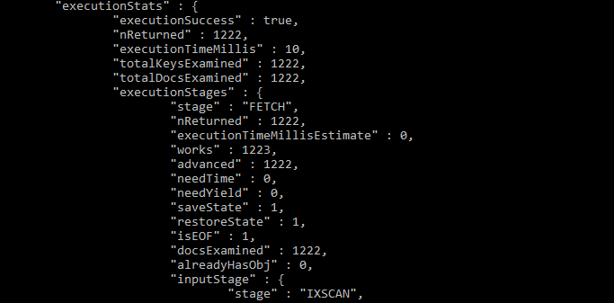
After creating Index executionTimeMills: 10

